Slide 1
20th Century Music
Kenny Lim

Slide 2
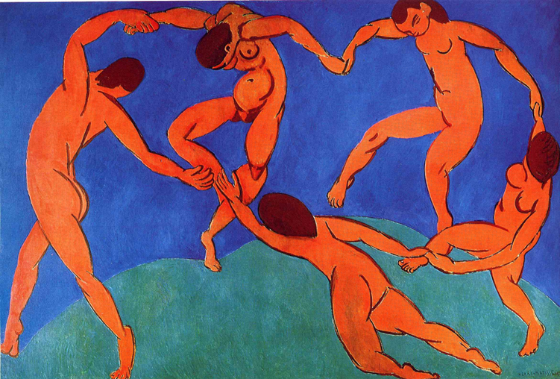
Henri Matisse: Dance (1910)

Slide 3
Characteristics
Tone color:
•Noiselike & percussive sound are often used
•Instruments are played from the very top / very bottom of their ranges
•Uncommon technique became normal: e.g. glissando
•Occasional use of noisemakers: e.g. typewriters, sirens, automobile brake drums
•Piano is often used to add a percussive edge to the sound of an orchestra; in contrast to the romantics, who wanted the instrument to ‘sing’

Slide 4
Harmony
•New chord structures are introduced
•Traditional distinction of consonance and dissonance chord are abandoned
•20th century composers create fresh harmonies by placing one traditional chord against another,. Such a combination of two chords heard at the same time is called polychord.
•Harmonic resources were also extended through the tone cluster (chord made up of tones only a half step or a whole step apart)

Slide 5
Rhythm
•The rhythm vocabulary of music was expanded, with increased emphasis on irregularity and unpredictability.
•Rhythm is used to generate power, drive and excitement
•In many 20th century compositions, beats are grouped irregularly.
•In some modern music the meter changes with almost every bar. (1-2-3, 1-2-3-4, 1-2-3-4-5, 1-2-3, 1-2-3-4 etc.)
•The rhythmic resources of 20th century music were also expanded through unconventional meters (meter with 5 / 7 beats to the measure) e.g. 8 quick pulses in a measure may be subdivided 3+3+2

Slide 6
Melody
•Melodies are difficult to sing & unpredictable due to the rhythmic irregularity and changing meters
•Not tied to major / minor scale
•Based on all twelve chromatic tones

Slide 7
Style of Compositions
Three Main Music Development Trends
Impressionism
Neoclassicism
Expressionism

Slide 8
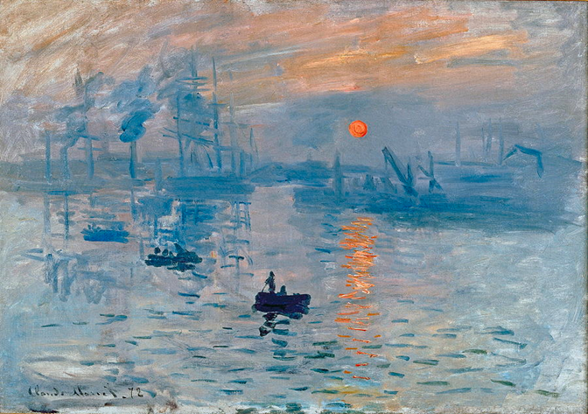
Impressionism and Symbolism
Impression: Sunrise by Claude Monet

Slide 9
Impressionism
French symbolist Poetry
•Musical style, which stresses tone color, atmosphere, and fluidity
•Emphasis on the reality of the created paint surface itself.
•Impressionist painters broke from traditional depictions of reality, writers called symbolists rebelled against the conventions of French poetry.
•Artistic and literary movement that suggested ideas through symbols and emphasized the meaning behind the forms, lines, shapes, and colors.

Slide 10
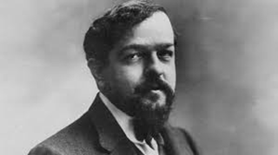
Claude Debussy (1862 - 1918)
•French composer
•Won the highest award in France for composers, the Prix de Rome.
•Music sounds free and spontaneous
•Strings and brasses are often muted, the sound seems come from far off
•Frequent use of damper pedal
•Church modes, pentatonic & whole-tone scales are frequently used compared to the diatonic scale
•Compositions: - Reflection in the Water , Clouds, Prelude to the afternoon of a Faun

Slide 11
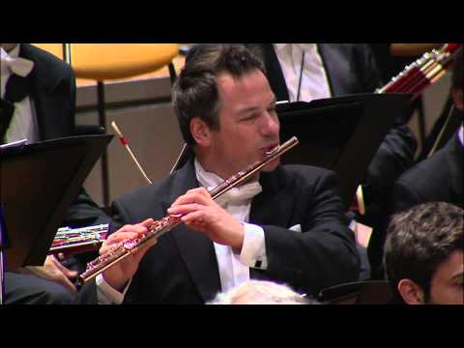

Slide 12
Neo-Classicism
•Some works between 1920 – 1950
•Composer such as Igor Stravinsky and Paul Hindemith
•Not merely a revival of old forms and styles; it uses earlier techniques to organize twentieth-century harmonies and rhythm
•Neoclassical compositions are modeled after Bach’s music
•Neoclassical composers turn away from program music and the gigantic orchestras favored at the time, preferred absolute music for chamber groups.

Slide 13
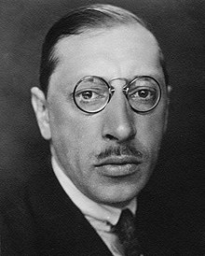
Igor Stravinsky (1882 - 1971)
•Restless innovator who influenced three generations of composers and inspired many painters, writers, and choreographers.
•Friend of cultural giants such as Picasso and T. S. Eliot
•President John F. Kennedy honored him at a White house dinner in his eightieth year
•By 1950s he adopted twelve-tone system
•Unmistakable “Stravinsky sound”
•Tone colors are dry and clear; beat is strong and regular
•His music abounds in changing and irregular meters
•Abrupt shifts of musical form

Slide 14
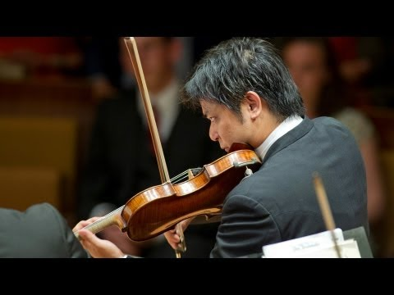

Slide 15
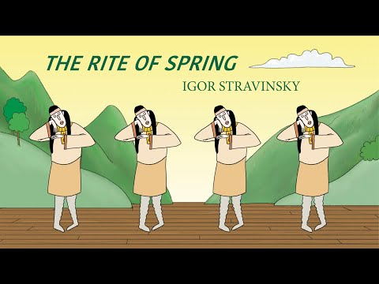

Slide 16
Expressionism
Atonality
Musical style stressing intense, subjective emotions and harsh dissonance
Typical of German and Austrian music of the early 20th century
Schoenberg is the most important expressionist composer
•Involved all the twelve tones in the chromatic scales
•All twelve tones are used without regards to major or minor scales
•By avoiding the establishment of a key, modulation is excluded

Slide 17
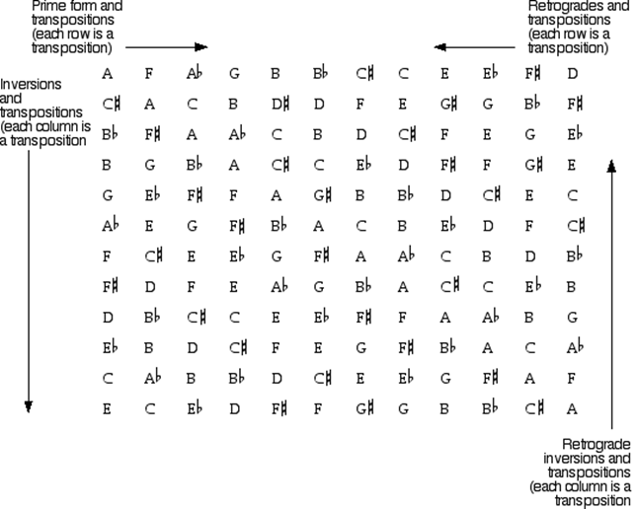
Twelve-tone system

Slide 18
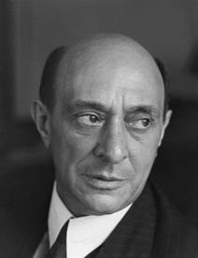
Arnold Schoenberg (1874 - 1951)
•Born in Vienna
•Almost entirely self-taught musician
•Around 1908 he abandoned traditional tonal system and worked on atonal system
•Became professor in University of California Los Angeles
•Twelve-tone system was adopted increasingly by composer throughout the world shortly after his death in 1951

Slide 19
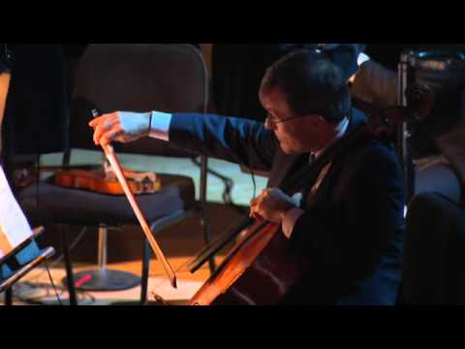

Slide 20
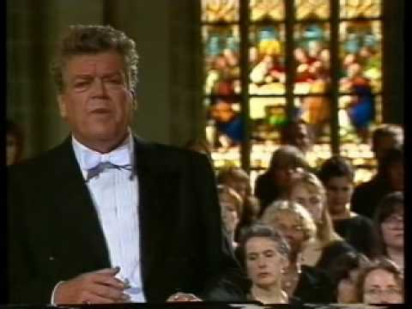

Slide 21
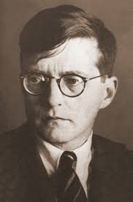
Dmitri Shostakovich (1906 - 1975)
•Leading composer of the Soviet Union
•Highly honoured members of the Soviet society
•In 1948 got blacklisted by Soviet union
•A year later he was returned in to favor after Stalin personally asked him to represent the Soviet Union at a World Peace Congress in New York

Slide 22
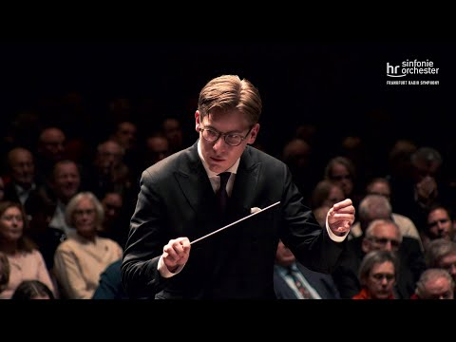

Slide 23
Nationalism in America after 1900
•Extraordinarily rich and diverse due to the country’s multiethnic character
•American jazz and popular music became mainstream
•Techniques of producing electronic music, minimalist styles and chance music influenced composer around the world
•Colleges and universities played a vital role in developing musical culture

Slide 24
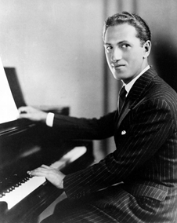
George Gershwin (1898 - 1937)
•Jazz influenced
•Songwriter
•The first American-born musician to appear on the cover of Time magazine

Slide 25
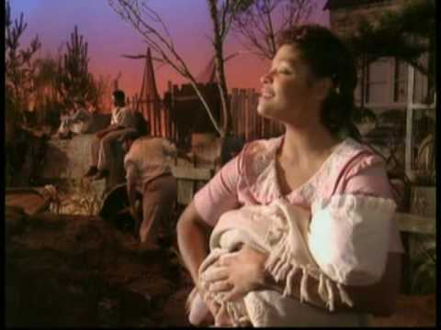

Slide 26
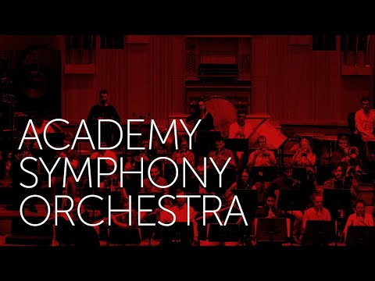

Slide 27
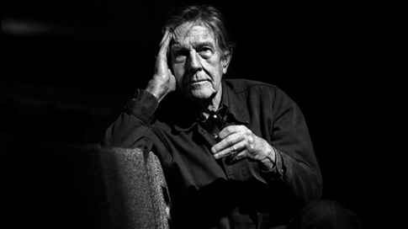
1945 onwards
John Cage
•Chance music
•Prepared piano

Slide 28
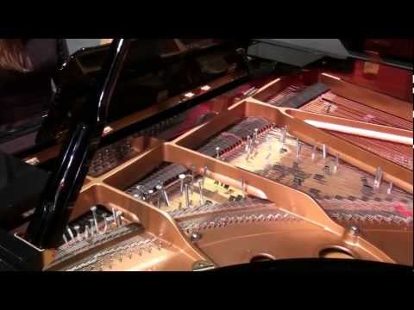

Slide 29
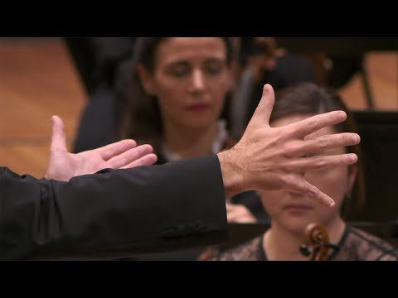

Slide 30
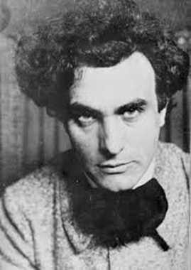
Edgard Varese (1883 - 1965)
•“Liberation of sound” vision
•Created in tape studio
•Designed to heard in the pavilion of Philips Radio Corporation
•Collaborated with the architect Le Corbusier

Slide 31
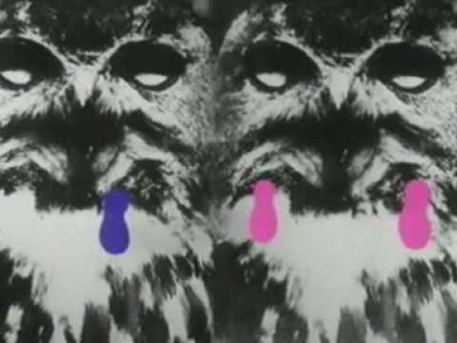

Slide 32
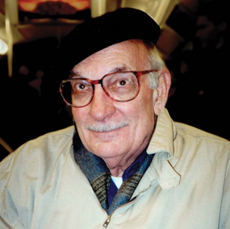
George Crumb (1929)
•Personal and emotionally intense
•Distinguished by imaginative use of novel and delicate tone colors
•Ancient Voices of Children (1970)
"I was intrigued by the idea of juxtaposing the seemingly incongruous: a suggestion of flamenco with a baroque quotation, or a reminiscence of Mahler with a breath of the Orient."

Slide 33
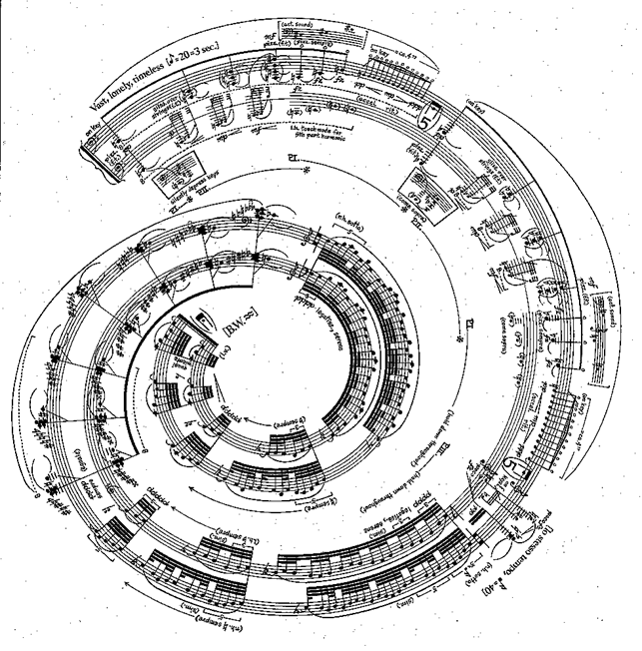

Slide 34
